Slide 1
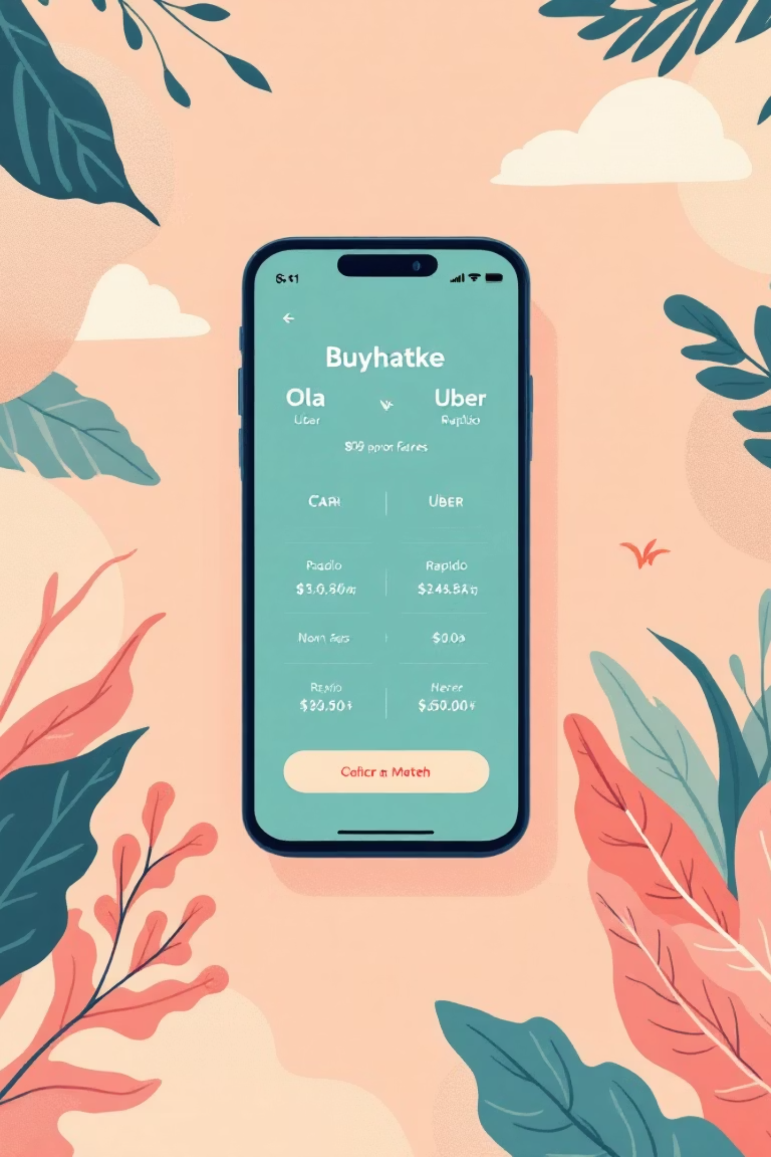

Unlocking Synergy through Buyhatke’s Cab Compare Feature 🚖
Buyhatke is a recognized leader in e-commerce price comparison and savings. We are applying that core expertise to mobility with the Cab Compare Feature, allowing users to compare live fares across major platforms like Ola, Uber, and Rapido.
The Current Gap: Low Visibility
Weak Mobility Association
The feature suffers from low visibility within the main app architecture, limiting organic discovery.
Users currently associate Buyhatke primarily with shopping, creating a weak link with daily mobility needs.
Minimal Repeat Engagement
Without a dedicated habit loop, repeat engagement and daily usage are significantly lower than potential.

Slide 2

Core Challenge: Creating Synergistic Daily Activity
How can Buyhatke connect shopping and ride savings to drive recurring user activity?
The ultimate goal is to boost awareness, engagement, and daily usage of the Cab Compare feature among our existing, loyal user base.

Slide 3

Understanding the Market & User Behavior 🔍
User Cost Sensitivity
Ineffective Alternatives
While users are highly cost-sensitive and comparison-driven, they often default to familiar apps (Ola/Uber) due to ingrained habit.
Platforms like Google Maps only show approximate fares, not live, actionable comparisons needed for immediate booking decisions.
Targeted User Base
Clear Market Demand
Buyhatke’s existing user base of students and professionals significantly overlaps with frequent cab users, providing an immediate audience.
Frequent search trends, such as “Ola vs Uber price,” indicate a high, latent demand for a reliable, aggregated fare comparison tool.

Slide 4
Strategic Opportunities for Growth
Leverage Trusted Brand Equity
Integrate Into Daily Routines
Build on Buyhatke’s established, trusted reputation for comparison and savings beyond e-commerce into the mobility sector.
Position Cab Compare not as a separate app, but as an essential tool for daily commute, transforming it into a habitual check.
Drive Cross-Feature Synergy
Form Daily Use Habits
Promote a unified value proposition: “Save while shopping, save while riding.” Connect savings from one vertical to another.
Utilize behavioral science principles, including gamification and personalization, to solidify the daily user habit loop.

Slide 5
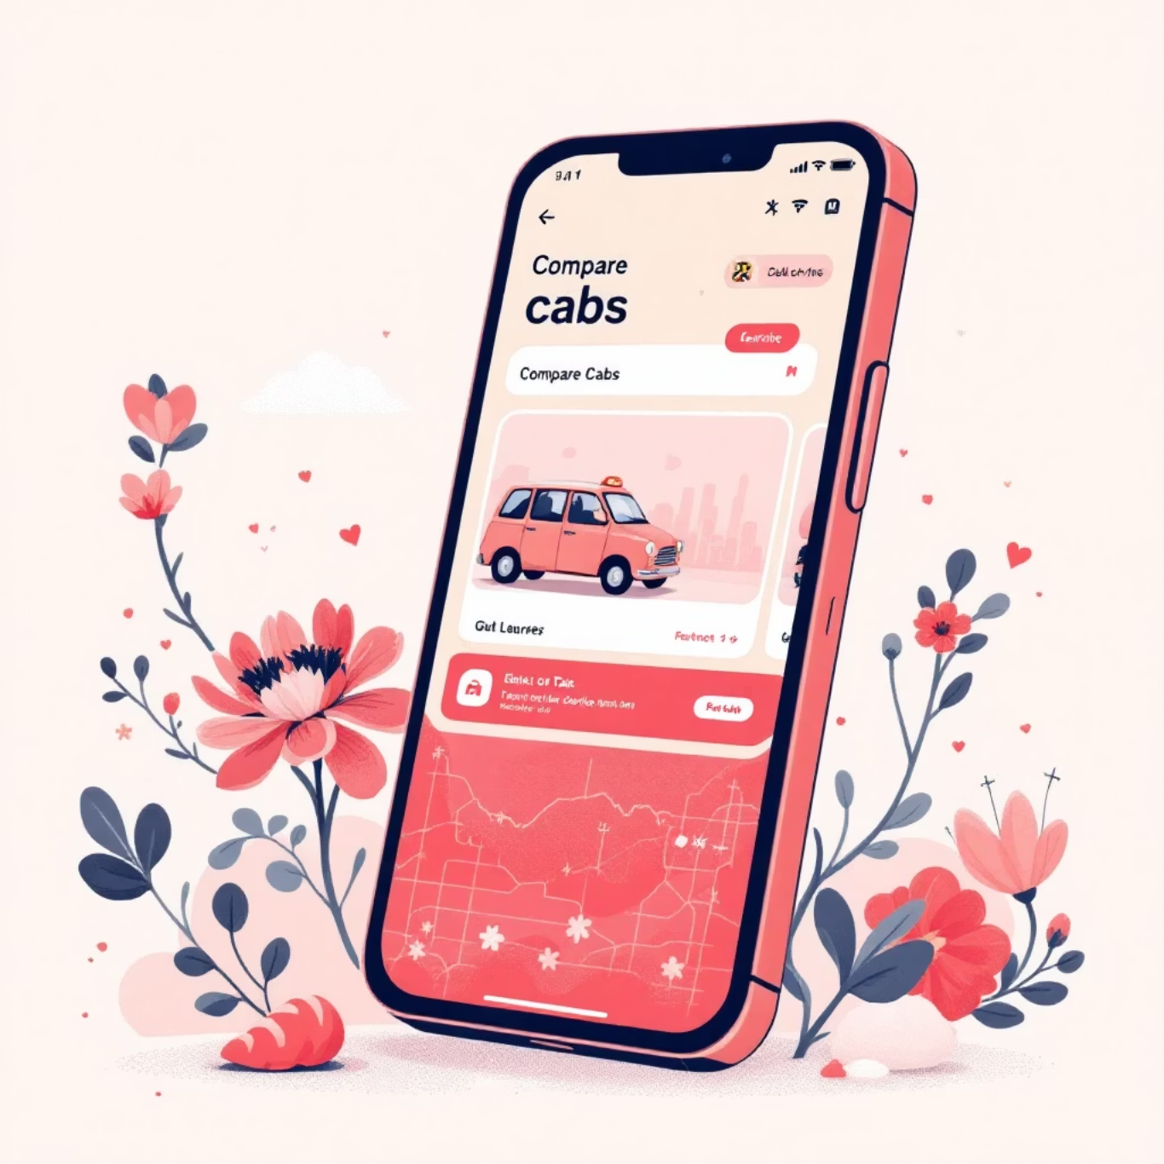
Product Enhancements: Making Cab Compare Core
UX Goal:
Reduce Friction, Create Habit Loop.
By streamlining access and adding intelligent features, we aim to increase the comparison frequency, making Buyhatke the first app users check before booking a ride.
Homepage Shortcut
Prominent "Compare Cabs" tile on the top navigation for instant access.
Smart Recall & Destinations
Auto-suggest frequently searched or recent destinations (e.g., Home ↔ Office) to skip manual input.
Personalized Fare Alerts
Proactive push notifications: "Fare to airport dropped by ₹40—book now and save!"
Interactive Map Visualization
Enhanced map showing nearby cabs and price options in a clear, compelling layout.

Slide 6

Marketing Strategy: #RideSmart with Buyhatke 📢
Tagline: “Because your money deserves the shortest ride.”
Referral Program
Gamification Rewards
"Invite friends to Cab Compare → earn ₹20 Buyhatke Coins that can be used for shopping deals."
"Compare 5 rides this week → win exclusive shopping coupons or loyalty points."
Cross-Feature Promotion
Leverage notifications: "Saved ₹200 on Flipkart? Save ₹50 on your next ride using Cab Compare!"

Slide 7

Implementation Roadmap (Phased Plan)
Phase 1: UI & Visibility
Phase 2: Awareness & Acquisition
Phase 3: Habit & Retention
Month 1–2: Focus on UI revamp, homepage tile integration, and backend stability.
Month 4–6: Implement personalization features (Smart Recall) and loyalty/gamification initiatives.
Month 3: Launch internal awareness campaigns, in-app banners, and the referral program.

Slide 8

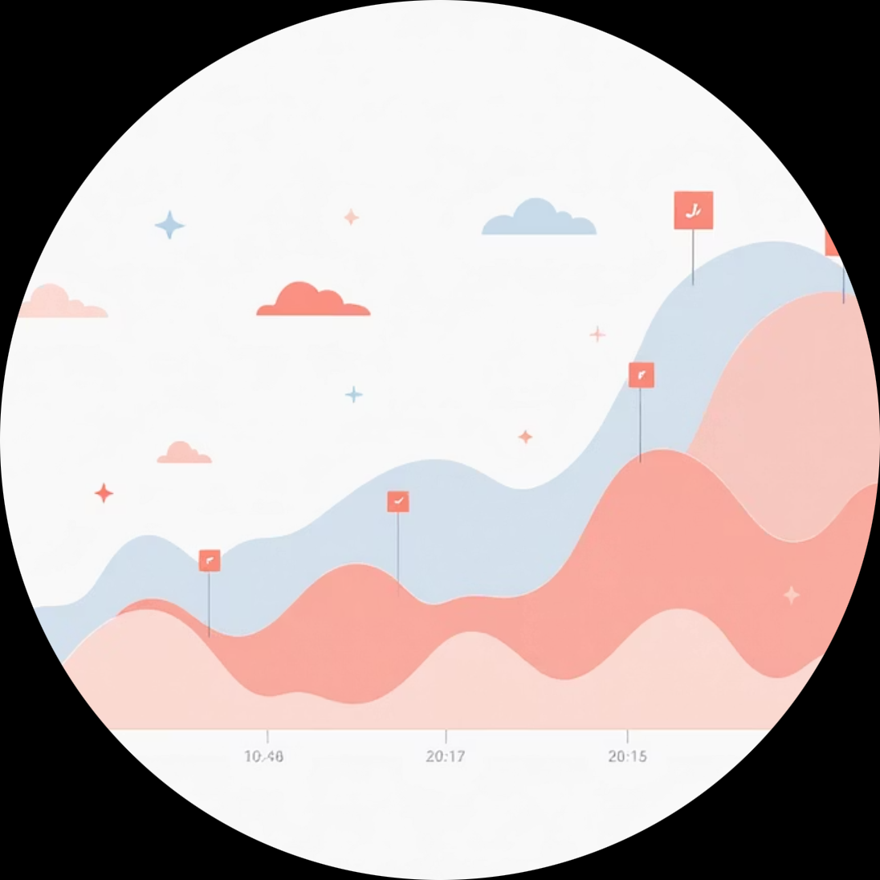

Anticipated Outcomes & Vision Snapshot 🌐
Strong Synergy
Higher Daily Engagement
Everyday Companion
A tighter connection between shopping deal-hunting and daily ride-fare optimization.
Users checking the app multiple times daily for fare comparisons, boosting overall session count.
Reinforce Buyhatke’s image as an indispensable, reliable Everyday Savings Companion.

Slide 9
Key Performance Indicators (KPIs) - 6-Month Targets 📈
These targets focus on behavioral change—moving users from occasional shoppers to daily savers across multiple feature sets.
Visibility – % users who view feature
Target: +60%
Engagement – Daily sessions in feature
Target: +40%
Retention – Weekly repeat users
Target: +25%
Cross-feature usage (deals + cabs)
Target: +35%
“Synergy Score” – users using 2+ features
Target: +30%

Slide 10




Long-Term Vision: A Daily Savings Ecosystem
Save Everywhere. Every Day. The Buyhatke Way.
E-commerce Savings
Ride Savings
Price comparison, coupon aggregation, and deal alerts.
Real-time cab fare comparisons across major providers.
Public Transit & EV
Local Service Deals
Long-term expansion to include bus, metro, and electric vehicle ride data.
Future integration of local offers and service comparisons (e.g., delivery).
Buyhatke evolves from a "shopping assistant" to an essential lifestyle savings companion, seamlessly integrated into every part of the user's spending habits.

